Slide 1

Presentation on
“WEATHER APp”
PRESENTED BY -:
Sanskar Upadhayay,
Krishna Kant Jha,
Syed Tausif Ahmed
Under Guidance of -:
MR. Dhiraj Kumar
(Senior Mentor of Stack Route)

Slide 2
CONTENT OF THE SLIDES
Introduction and application of the capstone project
work.
Problem statement and objective(s)
Methodology/tools to be used
Project features and components

Slide 3
Objective
The main objective of the Weather App is User can search for a city to know its weather and based on forecast he should plan his journey.
The purpose of the project is to build an application program to reduce the manual work for managing forecast information.
User can add his favorite cities in the watchlist to see their weather information later.

Slide 4
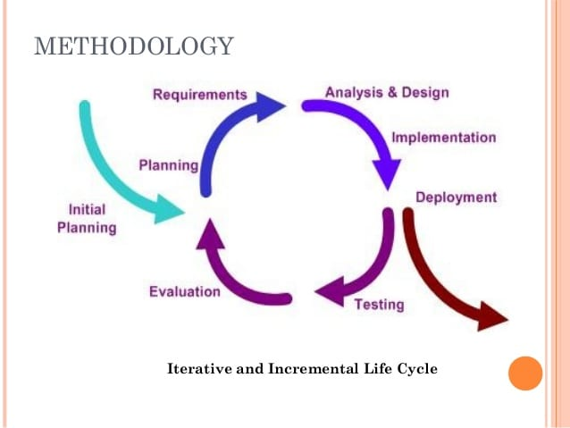
ement system
using MERN – stack

Slide 5
introduction what is mern stack
A stack is the mixture of technologies used to create Web applications. Any web application will be made utilizing various technologies like (frameworks, libraries, databases).
MERN stands for MongoDB, Express, React, Node, after the four key technologies that make up the stack.
The MERN stack is a JavaScript stack that is intended to make Application Development process smoother.

Slide 6
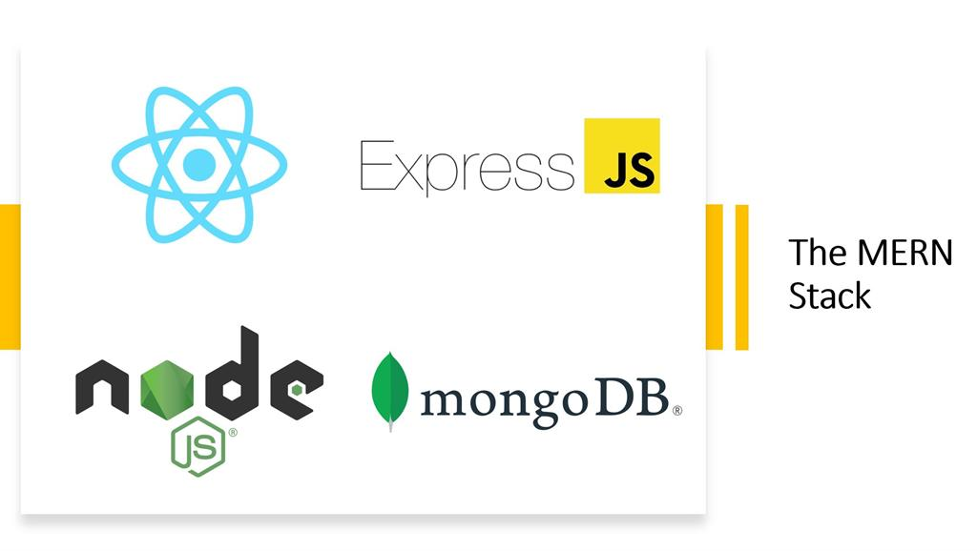

Slide 7
tools to be used
A “stack” refers to any combination of coding languages, tools, and frameworks developers use to create software products for their clients.
A stack contains different layers of components that play a vital role in the process of software product creation.
Client-side - Front-end (JSX, CSS, JavaScript, React, Material-Ui)
Server-side - Back-end (ExpressJs , NodeJs, MongoDB)
Testing - Mocha, Chai, Jest, Enzyme
Container – Docker
VCS - GitLab

Slide 8

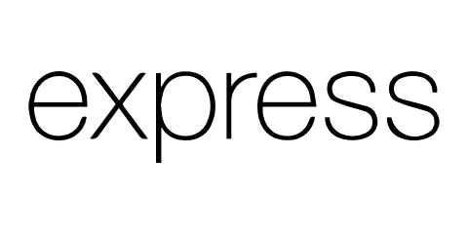

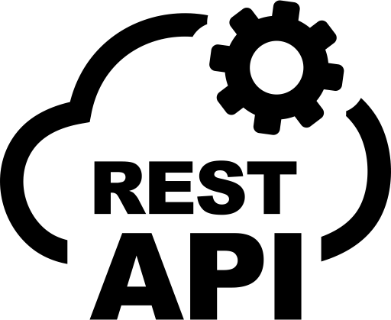








TECK-STACK :

Slide 9
1. Node JS
Originally built for Google Chrome and later on open-sourced, Node JS is a cross-platform run-time JavaScript environment used for executing JavaScript code outside of a browser. JavaScript was originally used for front-end scripting, but Node JS has enabled devs to use it to write command line tools and back-end scripts for the purpose of creating dynamic web page content before the page is sent to the user's web browser.
Node JS was designed with an idea of allowing devs to build scalable network applications.

Slide 10
2. React JS
This is a JavaScript library used for building user interfaces. Originally created by a software engineer who worked for Facebook, React was later on open-sourced.
This specific library is often used for creating views rendered in HTML. The views that you create in Reach declarative, which means that you don’t have to deploy additional time on managing the changes and effects they have on the data.
React uses a full-featured programming language (JavaScript) to construct repetitive or conditional DOM elements.
With React, the same code can run on both the server and the browser.

Slide 11
3. Express JS
This is also a free, open-source software, it can be classified as a web application framework for Node.js. To be more precise, Express JS is made for developing web apps and APIs.
Instead of manually writing full web server code in Node.js, developers use this MERN component to simplify the coding process. The best feature of this framework is that devs don’t repeat the same code over and over, as they would with writing Node.js code in the HTTP module.

Slide 12
4. Mongo DB
This is a free open-source, cross-platform document-oriented database program. It is classified as a No SQL database program, which means that data is stored in flexible documents with JSON-based query language. This also means that the size of the content number of fields in the documents tends to vary. The whole data is structured in a way to be prone to change over time.
MongoDB is known as a flexible solution that is always easy to scale.

Slide 13
Project feature and component
User Registration
User LogIn
Access of Current Weather
Add to Watchlist
Watchlist
Forgot Password

Slide 14
MicroServices
Authentication :
Handles authentication operations such as register user, login user, reset password and saves into database.
WatchList :
Handles the operations of saving the cities to list and deleting and managing on request by the user for future into the database.
WeatherApi :
Handles the fetching of data from 3rd party openweather api when requested by the user for a certain city.

Slide 15
Project Overview
Register
Add To
Watchlist
API
Authentication
Home
LogIn
Profile
Search
Mongo
DB
Current
Weather
API

Slide 16
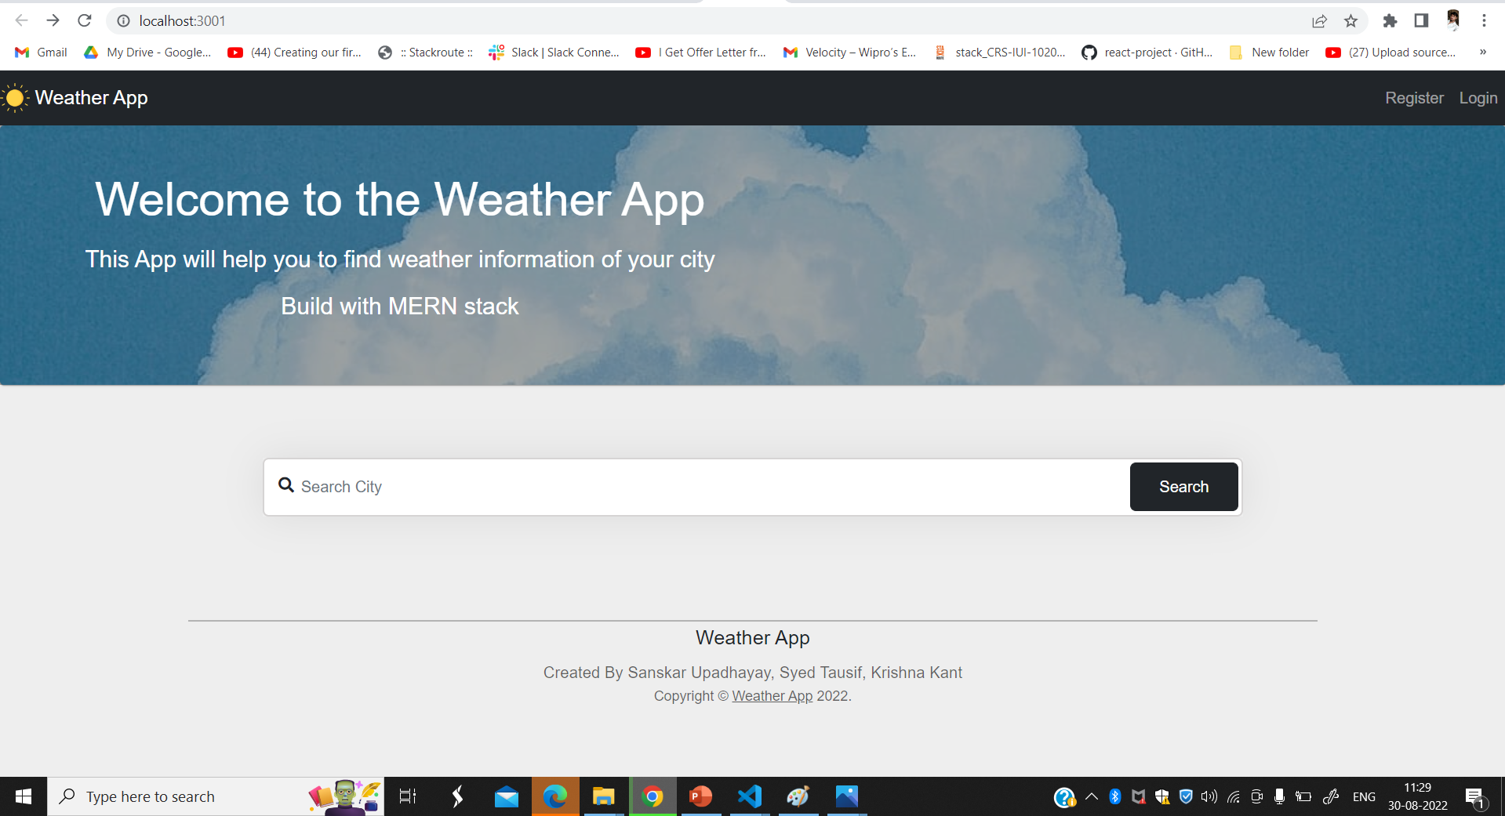
Project Snap-shot

Slide 17
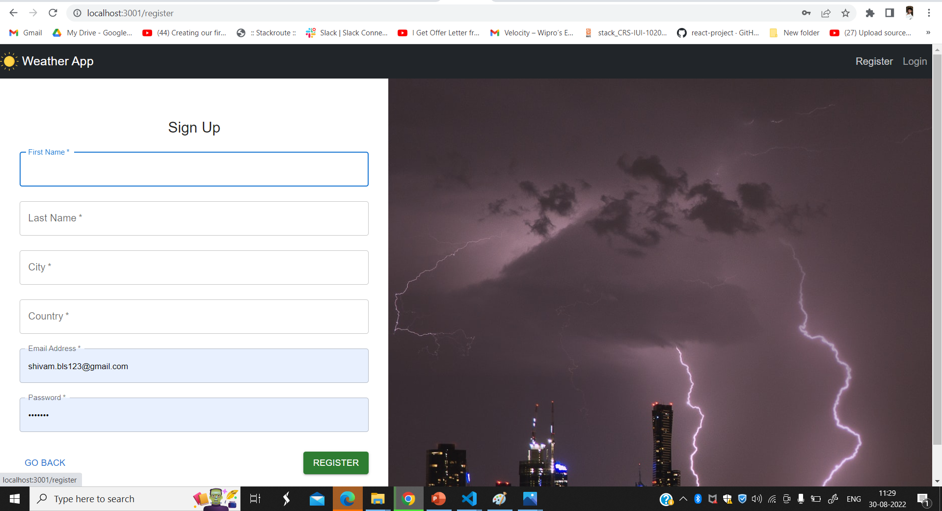

Slide 18
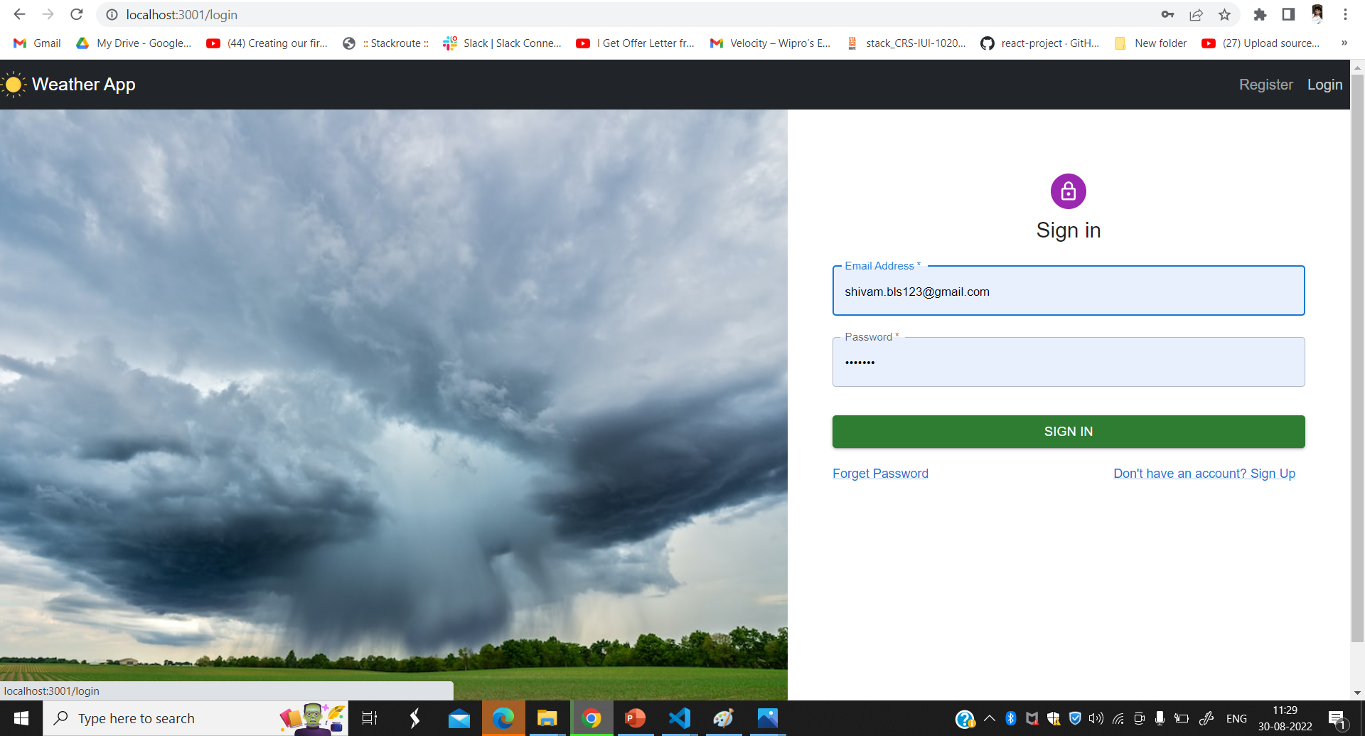

Slide 19
APPLICATIONS
User can be able to register with the application so that he can login and use the functionalities of the application.
User can be able to login with his Gmail account in order to access the functionalities of the application.
User can be able to search resources to view their details.
User can be able to save resources to a watchlist so that I can access them later.
User can be able to access items saved and delete to his watchlist.

Slide 20
THANK YOU

